Slide 1



Slide 2


Slide 3


Slide 4
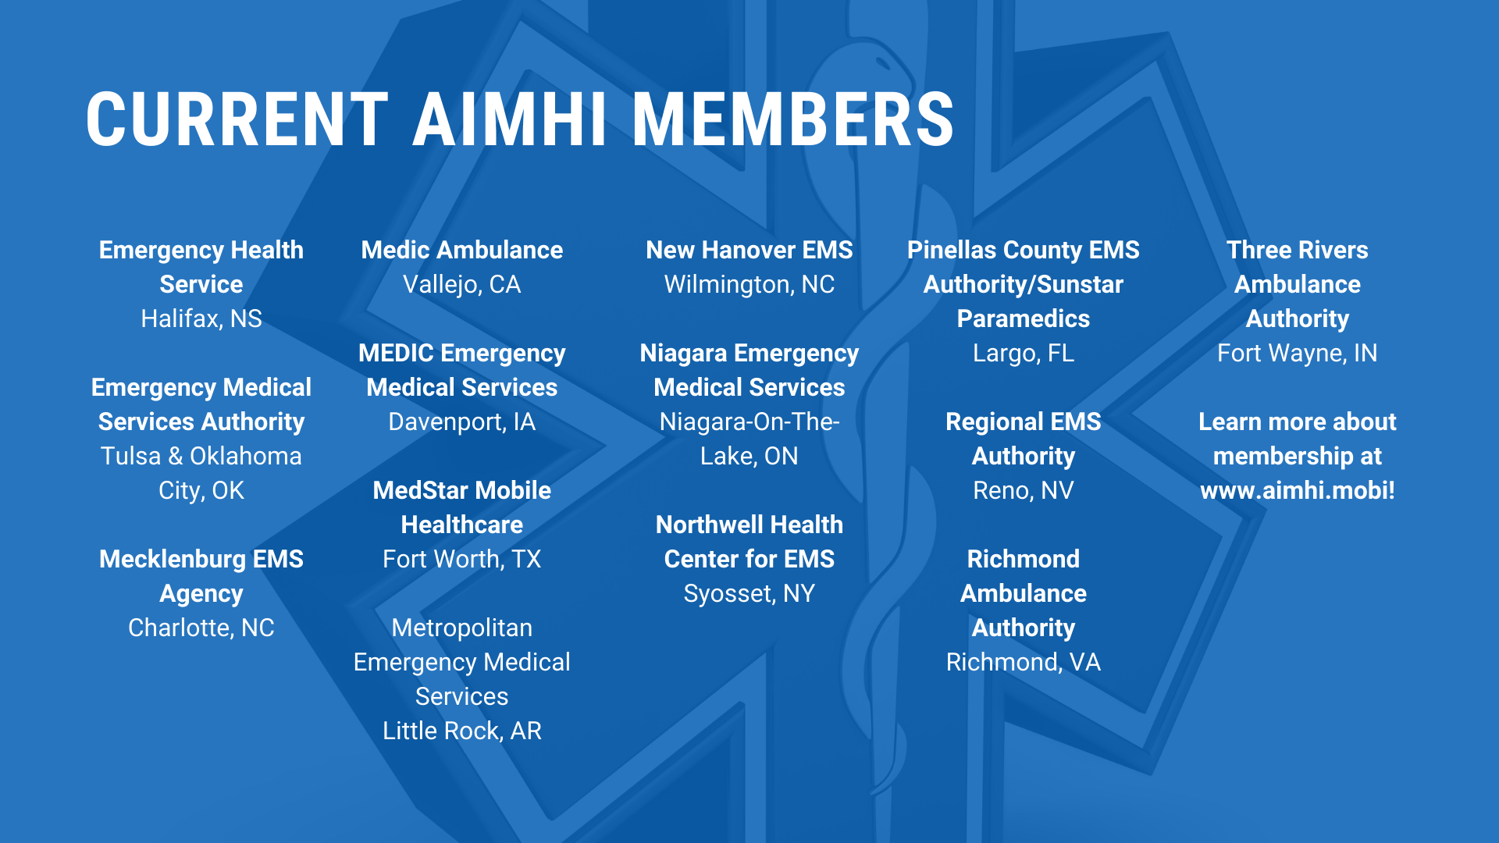

Slide 5

Using Clinical Evidence and Outcome Data to Inform Response Plan Design
An Evidenced-based Approach to Response Plan Protocols
AIMHI
March 23, 2021

Slide 6
Presenters
Dr. Doug Munkley, MD, MCFP (EM)
Medical Director, Niagara EMS
Rick Ferron, MHM, B.Ed ADED, ACP
Deputy Chief, System Performance
Niagara EMS

Slide 7
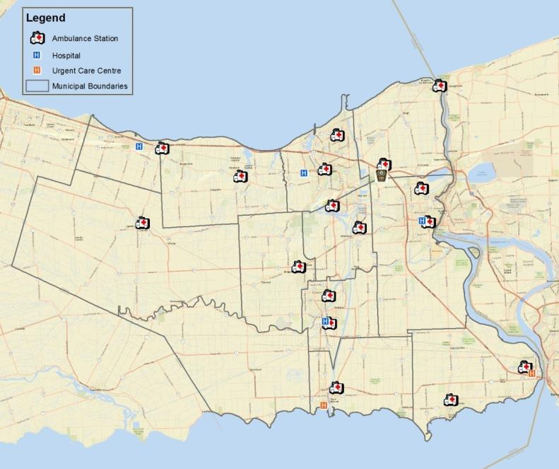
Background
17 ambulance stations (full time)
43 ambulances (daily peak staffing of 33, Approx. 75% ALS)
  Emergency Communications Nurse (ECN) 16 hours/day
  2 Community Assessment and Referral (CARE) Teams
  1 Falls Intervention Team (FIT)
  1 Mental Health & Addictions Intervention Team (MHART)
  1 Community Response Unit
  1 Community Paramedic Unit
  Medical Staffing, Consumption & Treatment Site
Dispatch Center-Accredited IAED Centre of Excellence
Notes:
Self sufficiency is critical; water on three sides, rural to South West and large urban center to North West that is already strained.
Add call volume

Slide 8
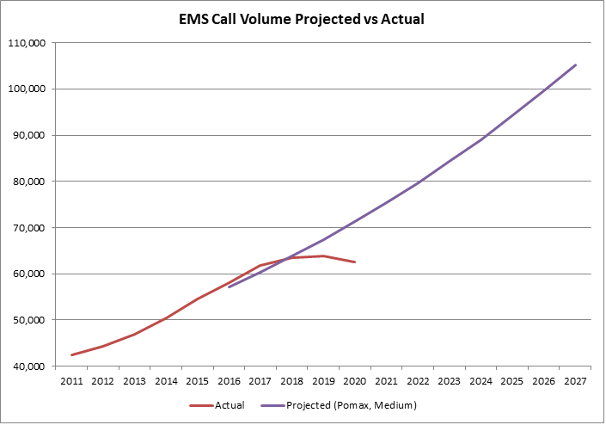
Call Volumes
System Transformation Starts
Notes:
NEMS Greatest call volume increase in Ontario 2007-2016 (Ontario MOHLTC)

Slide 9
System Transformation 2018-19
Revisit response policies
Emergency Communications Nurse System (ECNS)
Mobile Integrated Health (MIH)
Alternative Transport and Destination Options
Clinical Response Plan**
**shifts response planning from a solely time-based model, to an evidence-based model using clinical evidence and outcome data to inform decision making
Notes:
Collaborative process, many factors integrated--

Slide 10
Importance of Clinical Evidence in Response Planning
Lights and Sirens use impact on time, provider & public safety
  Numerous studies demonstrating very little impact on time, significant danger to providers and public
Impact of ‘Time’ on patient outcomes
  Little evidence positively linking evidence with outcomes in most cases
Need to ‘get it right’
  Not just looking at under triage risks, also consider impact of resource depletion

Slide 11


The Stakes are High
Notes:
Ontario, many systems send up 85% of calls out as ‘highest priority’ lights and sirens.

Slide 12
Evidence Considered-Examples
Lights and Sirens Use—Efficacy, Safety
    5,977,612 calls from 1,187 agencies…85.8% utilized RLS…only 6.9% resulted in PLSI
      Jeffrey L. Jarvis, Vaughn Hamilton, Mike Taigman & Lawrence H Brown (2020): Using Red Lights and Sirens for Emergency Ambulance Response: How Often are Potentially Life-Saving Interventions Performed? Prehosp Emerg Care. 2020 Aug 7:1-7.
Impact of Time on Patient Outcomes
    “An exploratory analysis suggested there may be a small beneficial effect of response ≤7 minutes 59 seconds for those who survived to become an inpatient“
      Blanchard IE, Doig CJ, Hagel BE, Anton AR, Zygun DA, Kortbeek JB, Powell DG, Williamson TS, Fick GH, Innes GD (2016): Emergency medical services response time and mortality in an urban setting. Prehosp Emerg Care. 2012 Jan-Mar;16(1):142-51
Notes:
Time on outcomes (in what circumstances does time have an impact on outcome?)
Patient attitudes (what do patients expect when 911 is used?)

Slide 13
Evidence Considered-Examples
Impact of Response Plan Changes on Patient Outcomes
    population based analysis, retrospective, linked outcome (mortality) data
      Tallon JM, Zheng L, Wei J, Dick W, Papadopoulos G, Djurdjev O (2020): Population-based analysis of the effect of a comprehensive, systematic change in an emergency medical services resource allocation plan on 24-hour mortality. CJEM. 2020 Jan;22(1):86-94
Patient Attitudes Towards Paramedic Service Response

Slide 14
Research Conducted
Law M, Coolen J, Haj-Ahmed Z, Ferron R. The Impact of Emergency Medical Services Response Time on Patient Outcomes: A Scoping Review of the Literature. National Association of EMS Physicians Conference, 2020
Law M, Coolen J, MacElhone S, Ferron R. Assessing Public Opinion on EMS and Potential Areas for Innovation. Submitted.
Notes:
Of the cases for which time was a factor, 86% were OHCA; the remaining 14% of time-sensitive cases included haemodynamically unstable trauma, neurotrauma, stroke, testicular torsion, ventricular fibrillation, and ventricular tachycardia. These are known to be highly time-sensitive emergencies, but they do not represent a large volume of EMS calls.
Of the 84 articles included in the study, 70% evaluated out-of-hospital cardiac arrest (OHCA) patients,
15% evaluated trauma patients, 7% evaluated a subset of patient presentations (multiple), 4%
evaluated stroke patients, and 4% evaluated other presentations (including testicular torsion, heart
failure, ventricular fibrillation, ventricular tachycardia, or sepsis).
● As such, the current literature on EMS response times is very limited with respect to diversity of patient
presentation.
○ OHCA accounts for a very small portion of patient presentations, yet it represents the
overwhelming majority of the literature on response times.
● The impact of EMS response time on more common patient presentations, such as falls, mental health
crises, or general illness/weakness, are not sufficiently captured in the literature.

Slide 15
Response Plan Evolution
2005--CTAS (acuity) on patient contact
  2008--Prior to Paramedic intervention
2008--Paramedic Interventions
  Used to determine both acuity and appropriate resource assignment
2019--MIH/ECN teams Effectiveness Measures
  Used to determine appropriate resource assignment
New (2020)—Population Based patient hospital outcome data, by determinant
Notes:
Dr. M

Slide 16
Patient Outcome Data--IDS
IDS=Integrated Decision Support
Ontario Hospital Association “collaborative junction” for sharing integrated health partner data
  hospitals, home and community care, primary care, community health centres, public health, regions
First EMS service to feed/access linked data in Ontario (April 2020)

Slide 17
Patient Outcome Data
1 and 7 day mortality (in field and in hospital)
ED diagnostics
ED procedures performed
3 day bounceback (return to ED)
# admitted, avg LOS
# admitted to ICU, avg LOS.

Slide 18
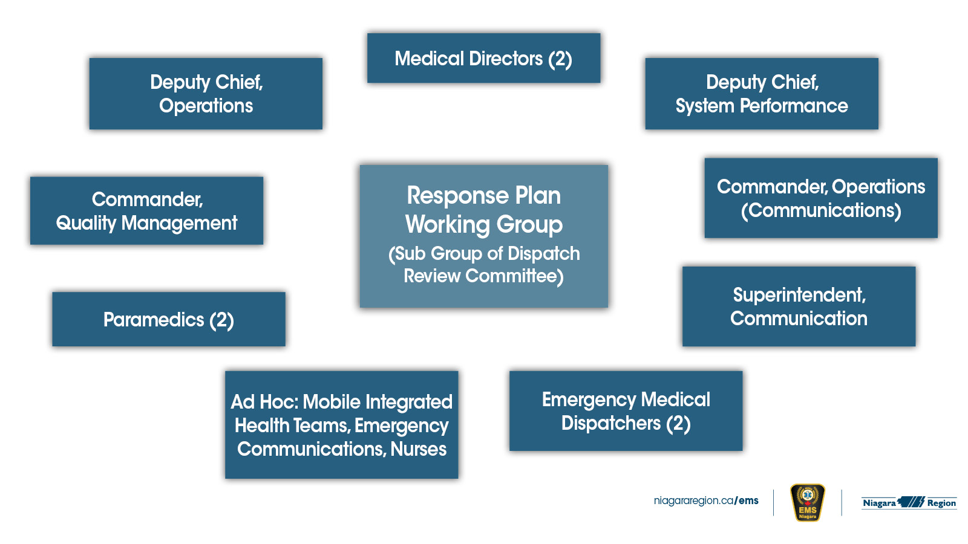

Slide 19

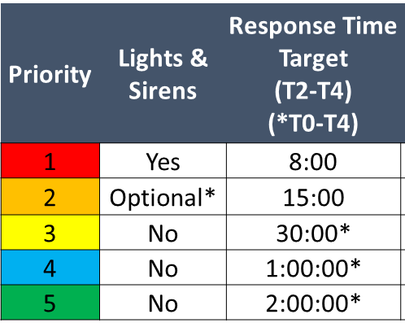
Response Plans* by Determinant (1500+)
*200+ possible Response Plan Variations
Notes:
200+ variations on response plan

Slide 20
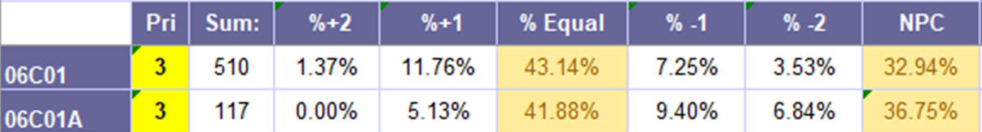
Response Priority Evaluation
Paramedic
Found Acuity (pre-intervention) vs Dispatch Priority

Slide 21
06C01 (Abnormal breathing) vs 6E01 (Ineffective Breathing) Using IDS Linked Outcome Data
Notes:
EXAMLE

Slide 22
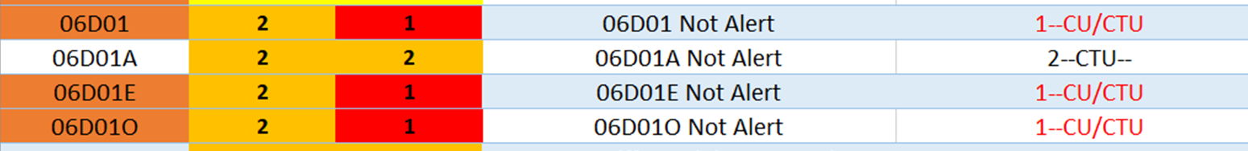
Revised Response Plan (based on outcome data)
An iterative process
Notes:
Iterative Process

Slide 23
Clinical Response Plan Year 1 Results
(using paramedic impression—CTAS)
 | 2018-2019 | 2019-2020
Lights and Sirens Responses | 24983 | 5708
Lights and Sirens % | 42.4% | 10.3%
% Capture | 5.8% | 24.7%
Mismatch % | 0.7% | 1.3%
Crew Election L&S (pri 2) |  | 457
Adjusted Mismatch% (incl pri 2) |  | 0.9%
Notes:
Capture = CTAS 1, or obviously dead/TOR/SCA on response where lights and sirens mandatory.
**Risk = CTAS 1, or obviously dead/TOR//SCA on response where lights and sirens not mandatory.
Adjusted Risk includes crew election to use warning systems where a CTAS 1 patient was found at first contact
-’Risk’ is a misnomer, as it is related to CTAS but no evidence of outcome differences

Slide 24
Next Steps
Population-based evaluation of patient outcomes (by determinant)
  Did methodology change patient outcomes
  any changes to risk?
Using information to inform future iterations of response plan
Share learnings with EMS community

Slide 25


Contact
d.munkley@cogeco.ca
niagararegion.ca/ems
richard.ferron@niagararegion.ca
niagararegion.ca/ems
@NiagaraEMS
Niagara EMS

Slide 26


MAEMSA/MedStar Mobile Healthcare Office of the Medical Director
Protocol Development & Credentialing

Slide 27

No disclosures or conflicts of interest

Slide 28

About Us
Self-operated Public Utility Model EMS System
15 cities in Tarrant County, TX
Urban and Suburban
1+ million residents over 438 sq mi
150,000+ requests for service
All ALS ambulance units (1 medic, 1 EMT)
15 Municipal FROs
All medical responders operate under unified protocols, credentialing, and QA through System’s OMD

Slide 29


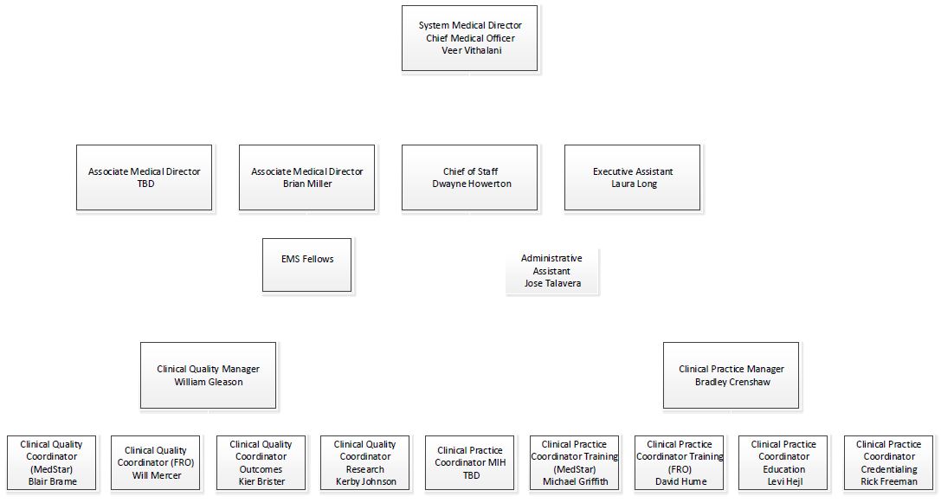

Slide 30
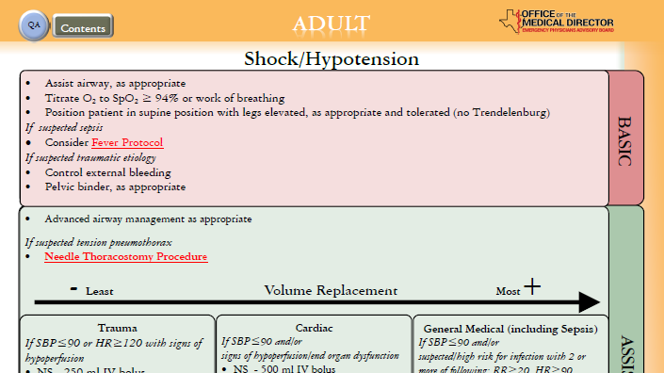
Evidence-Based
Protocol Development

Slide 31
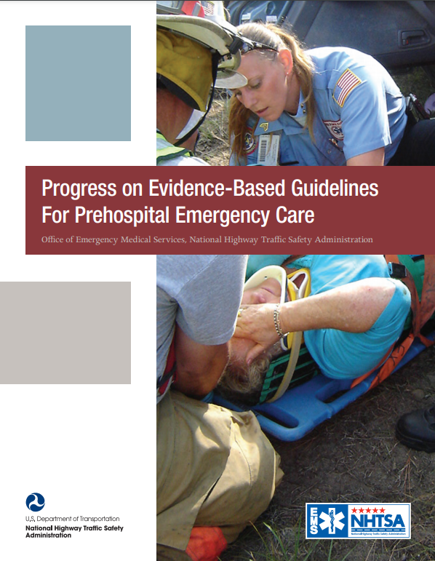
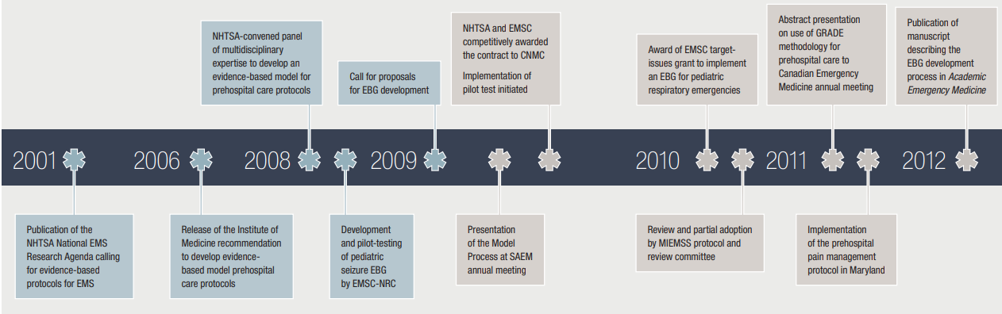
Evidence-Based Guidelines for Prehospital Care

Slide 32
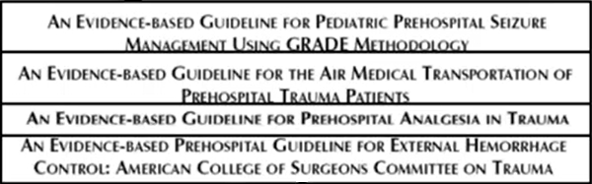








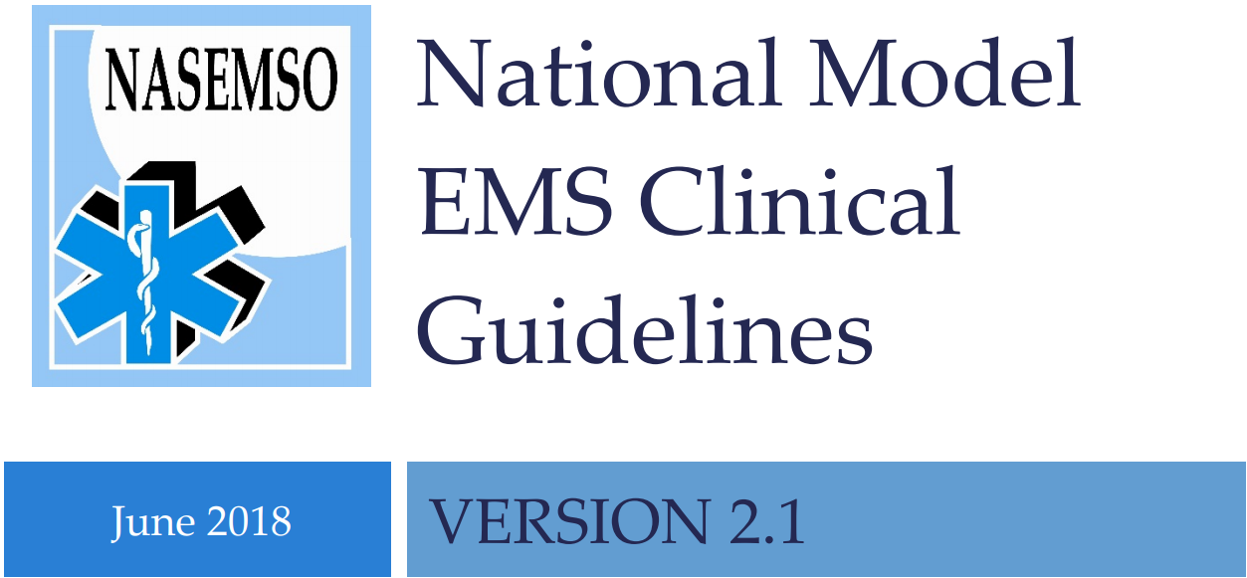


Evidence-Based Guidelines for Prehospital Care
2013
2014
2015
2016
2017
2018-21

Slide 33

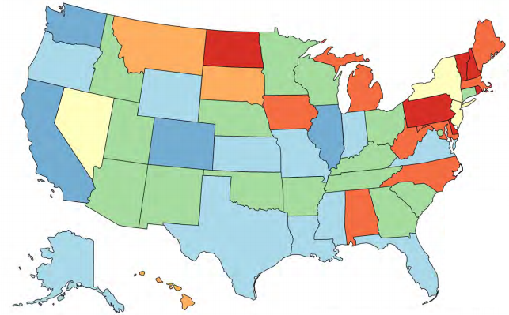
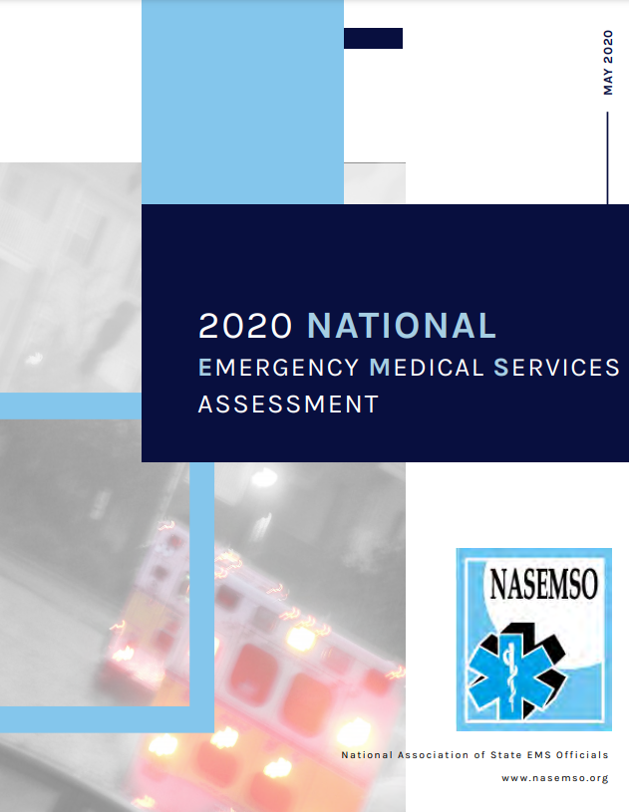
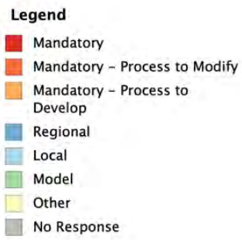

19 (34%) – Mandatory protocols with varying
abilities to develop/modify/revise
16 (29%) – Model protocols to shape local
12 (21%) – Local protocols
4 (7.0%) – Regional protocols
Notes:
https://nasemso.org/wp-content/uploads/2020-National-EMS-Assessment_Reduced-File-Size.pdf

Slide 34
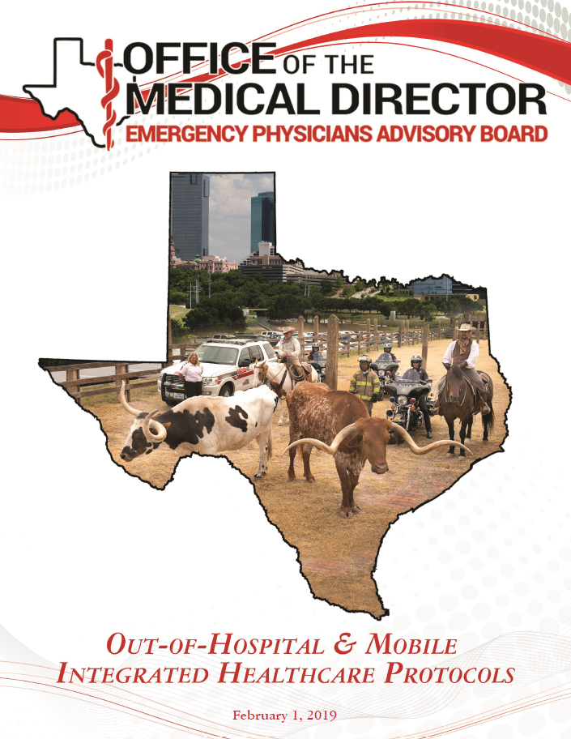
Initial Protocols Developed 2017
Two-Year
Revision/Credentialing Cycles
Minor revisions done in 2019

Slide 35
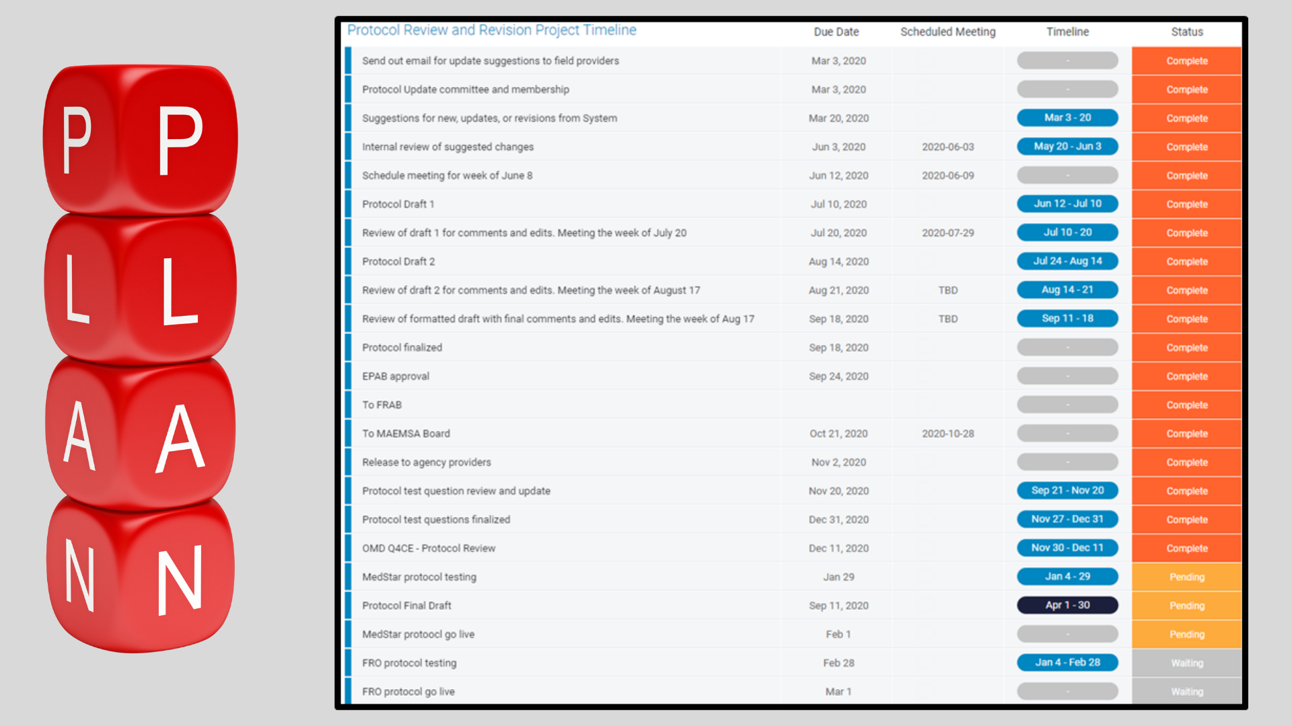

Slide 36


Slide 37


Slide 38
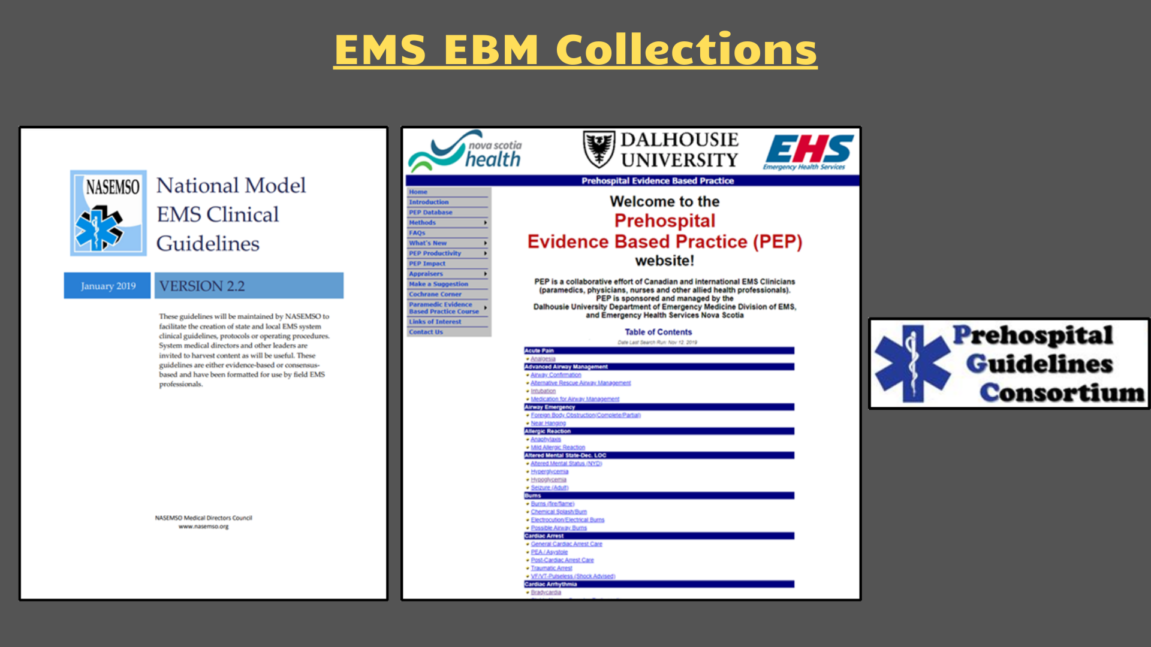
Notes:
https://nasemso.org/projects/model-ems-clinical-guidelines/
https://emspep.cdha.nshealth.ca/TOC.aspx
http://prehospitalguidelines.org/

Slide 39


Slide 40


Slide 41
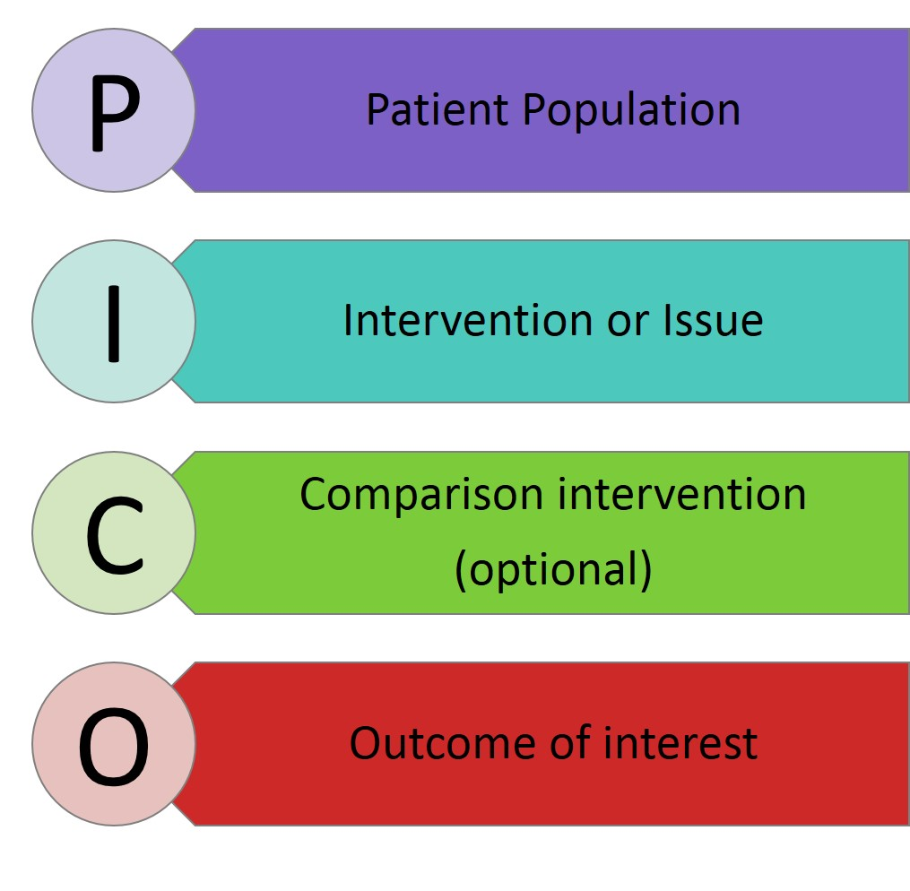
Targeted Protocol EBM Questions

Slide 42


Slide 43


Slide 44


Slide 45


Slide 46

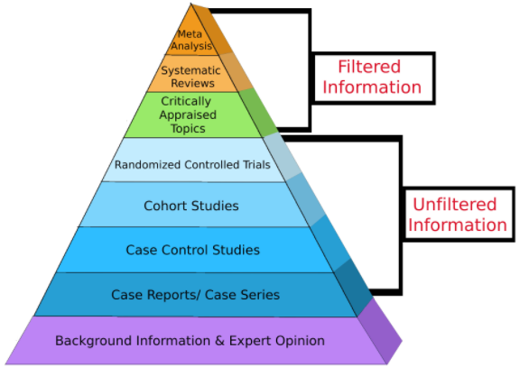
OMD Evaluation of EBM for Changes
Notes:
https://guides.himmelfarb.gwu.edu/ebm/studytypes

Slide 47
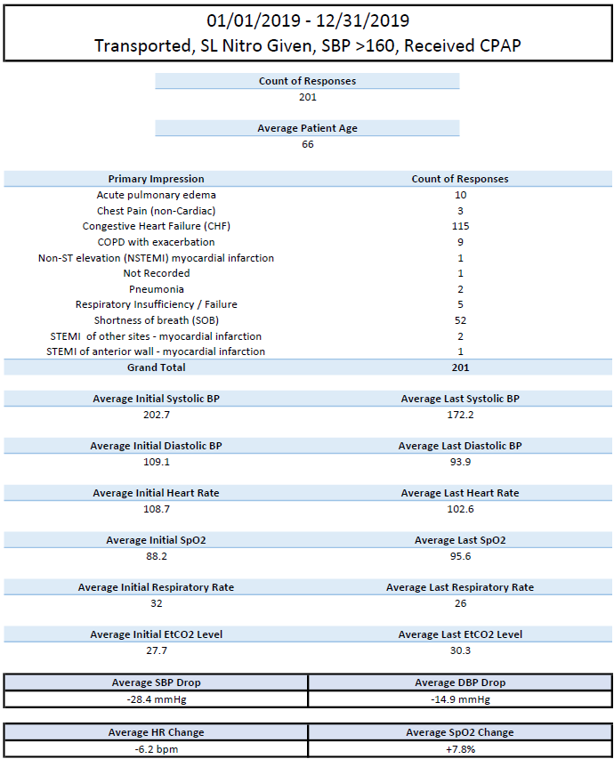
Data-Driven
Protocol Changes

Slide 48
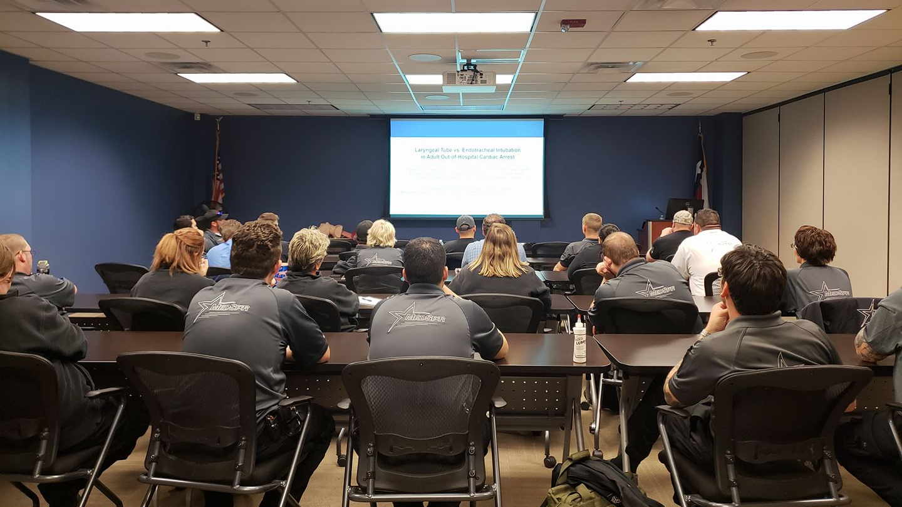
Protocol Review Committee
Operational Representatives
  FTOs
  Supervisors
  Leadership
  Logistics
OMD
  Medical Direction
  QA/QI
  Clinical Practice/Training
First Responder Organization Representatives

Slide 49


Proposed Protocol Change | EBM Supported | Operationally feasible | Medical Oversight Appropriate | Final Verdict
Ketorolac for pain management
TXA for GI Bleed related hemorrhagic shock
Withholding of Resuscitation for >73 yo, unwitnessed, non-shockable
Haloperidol → Droperidol
Addition of RSI | +/– |  |  | Roadmap to RSI

Slide 50
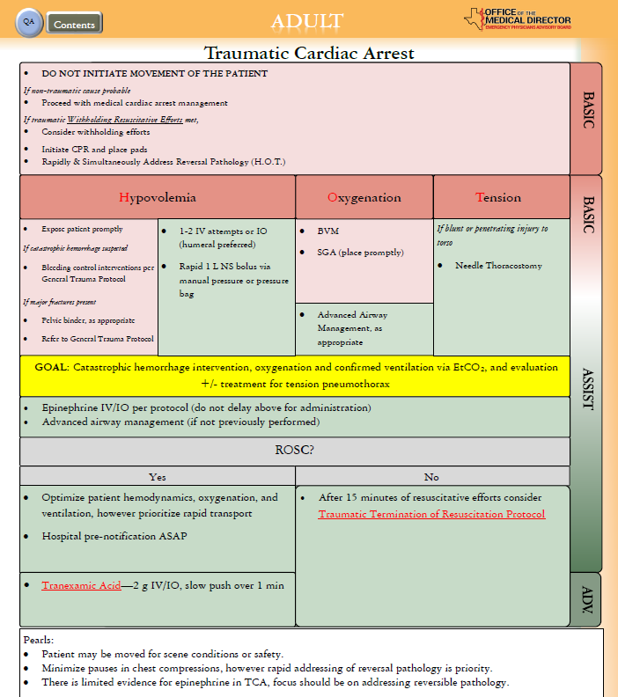
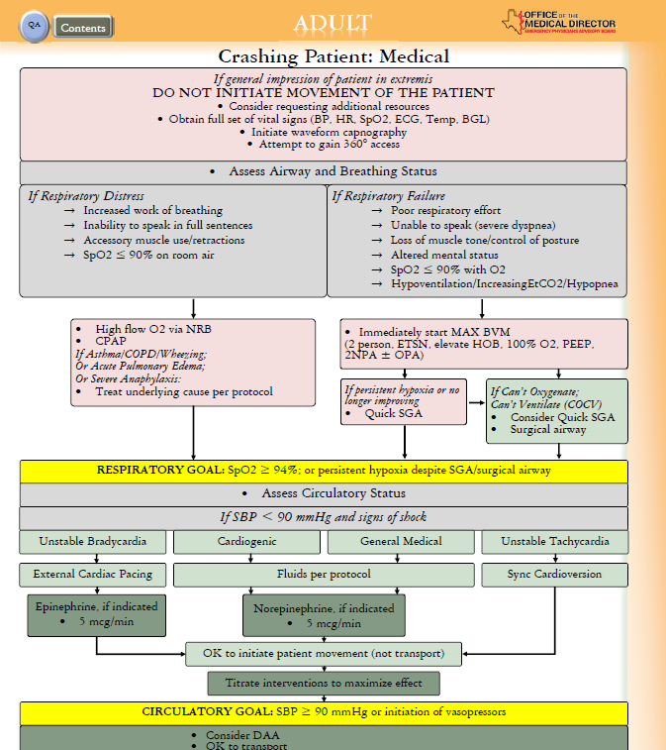
Protocol
Creation

Slide 51


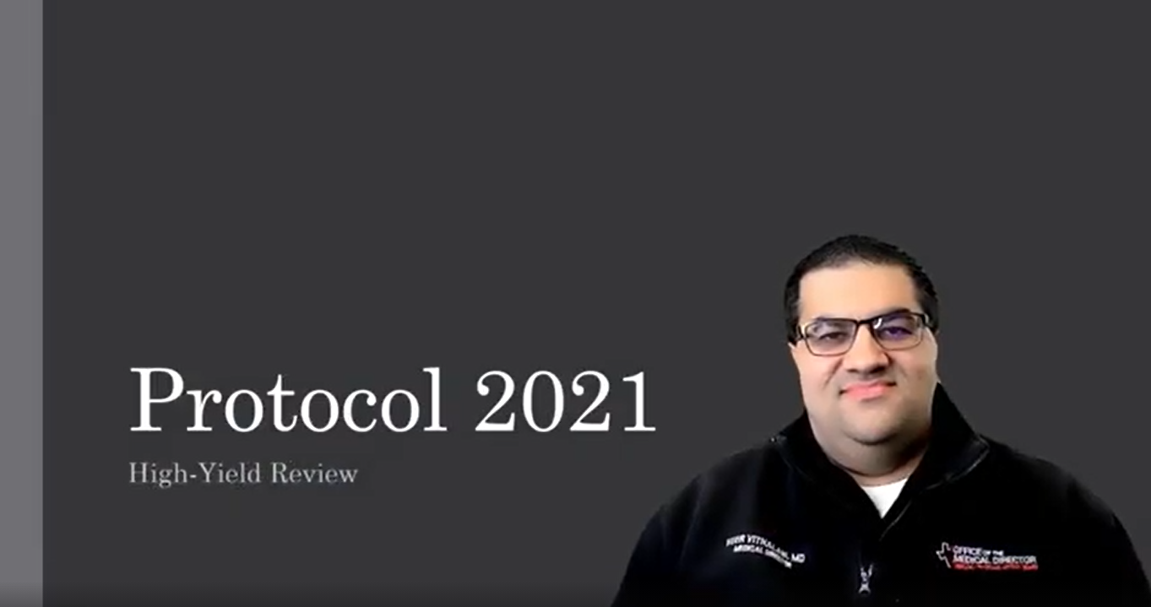
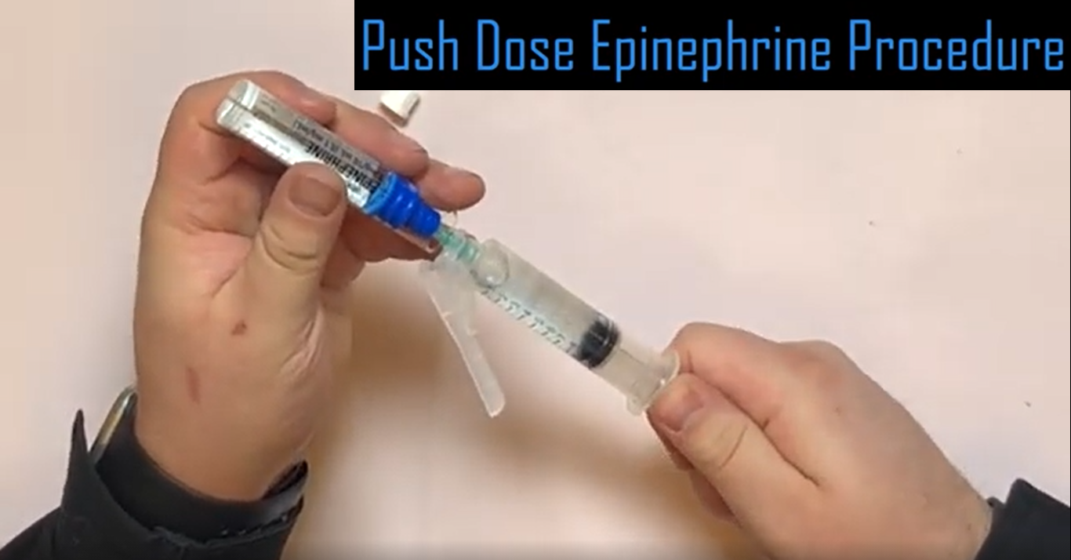
Protocol Rollout
Education/Training
System-wide LMS video content
  Full change overview
  Philosophy behind larger changes
Live quarterly CE review of major new protocol addition
New skill review videos
Credentialing
Protocol Testing
Skills verification

Slide 52

On the Horizon
Image by Jeremy Woodhouse / Getty Images
Living document vs. Periodic 2 yr Updates
Longitudinal Skills Verification

Slide 53


EMS Provider Credentialing
Notes:
https://www.ems.gov/pdf/National_EMS_Scope_of_Practice_Model_2019.pdf
Assessment for safe, entry-level cognitive and psychomotor skill competencies is primarily accomplished through national certification processes or state/provincial examinations. Once certified, there remains a need for focused, local standards of care based assessment of EMS providers. Simply stated, the diversity of clinical and operational protocols, scope(s) of practice, and equipment across different EMS organizations necessitates the local/regional verification of the EMS provider’s clinical and operational abilities. The process of credentialing must occur at the agency or EMS system level either by or under the direction of the local EMS physician medical director(s).

Slide 54
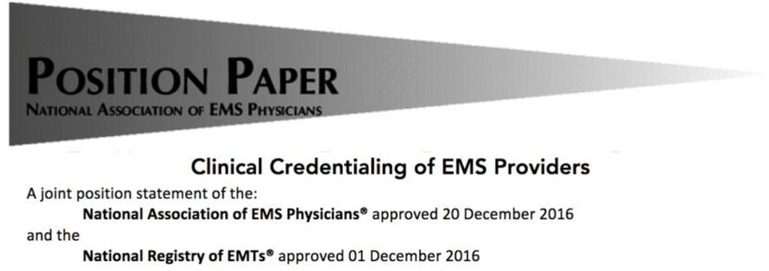
Credentialing involves at a minimum a demonstration of:
(1) Cognitive knowledge;
(2) mature, responsible affective ability;
(3) command of all involved psychomotor skills;
(4) integration of the above in the application of critical thinking in the provision of clinical care for all acuities of patients
....the public is best served when re-verification…occurs no less frequently than every two (2) years
Notes:
These aptitudes must be shown in the application of clinically oriented critical thinking, particularly in situations germane to that organization’s local practice of EMS medicine.

Slide 55
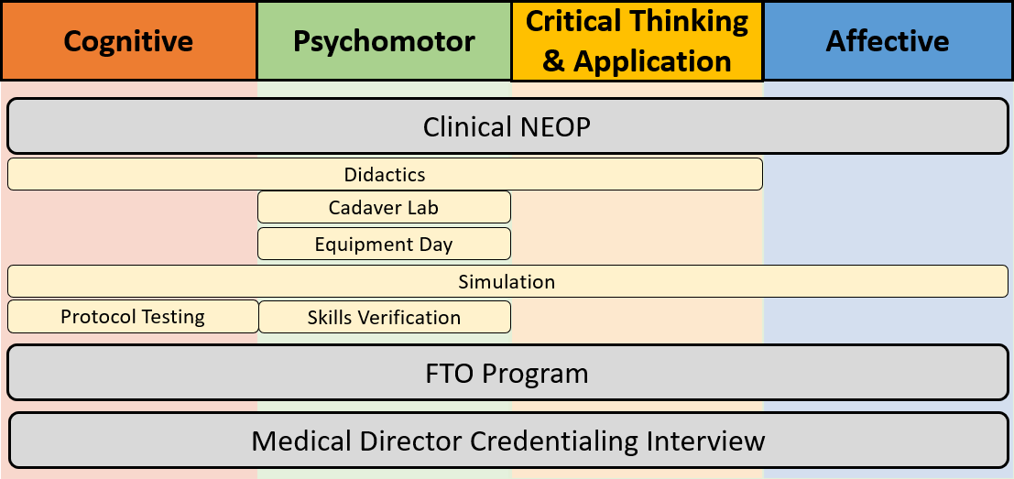
OMD Credentialing Process

Slide 56

Notes:
• Time ≠ experience ≠ competency
– Number of required shifts before credentialing?
– Minimum of critical patient contacts?
– specific illnesses, injuries, procedures, ages?
– Time “saved” on the front = time “spent” ahead

Slide 57
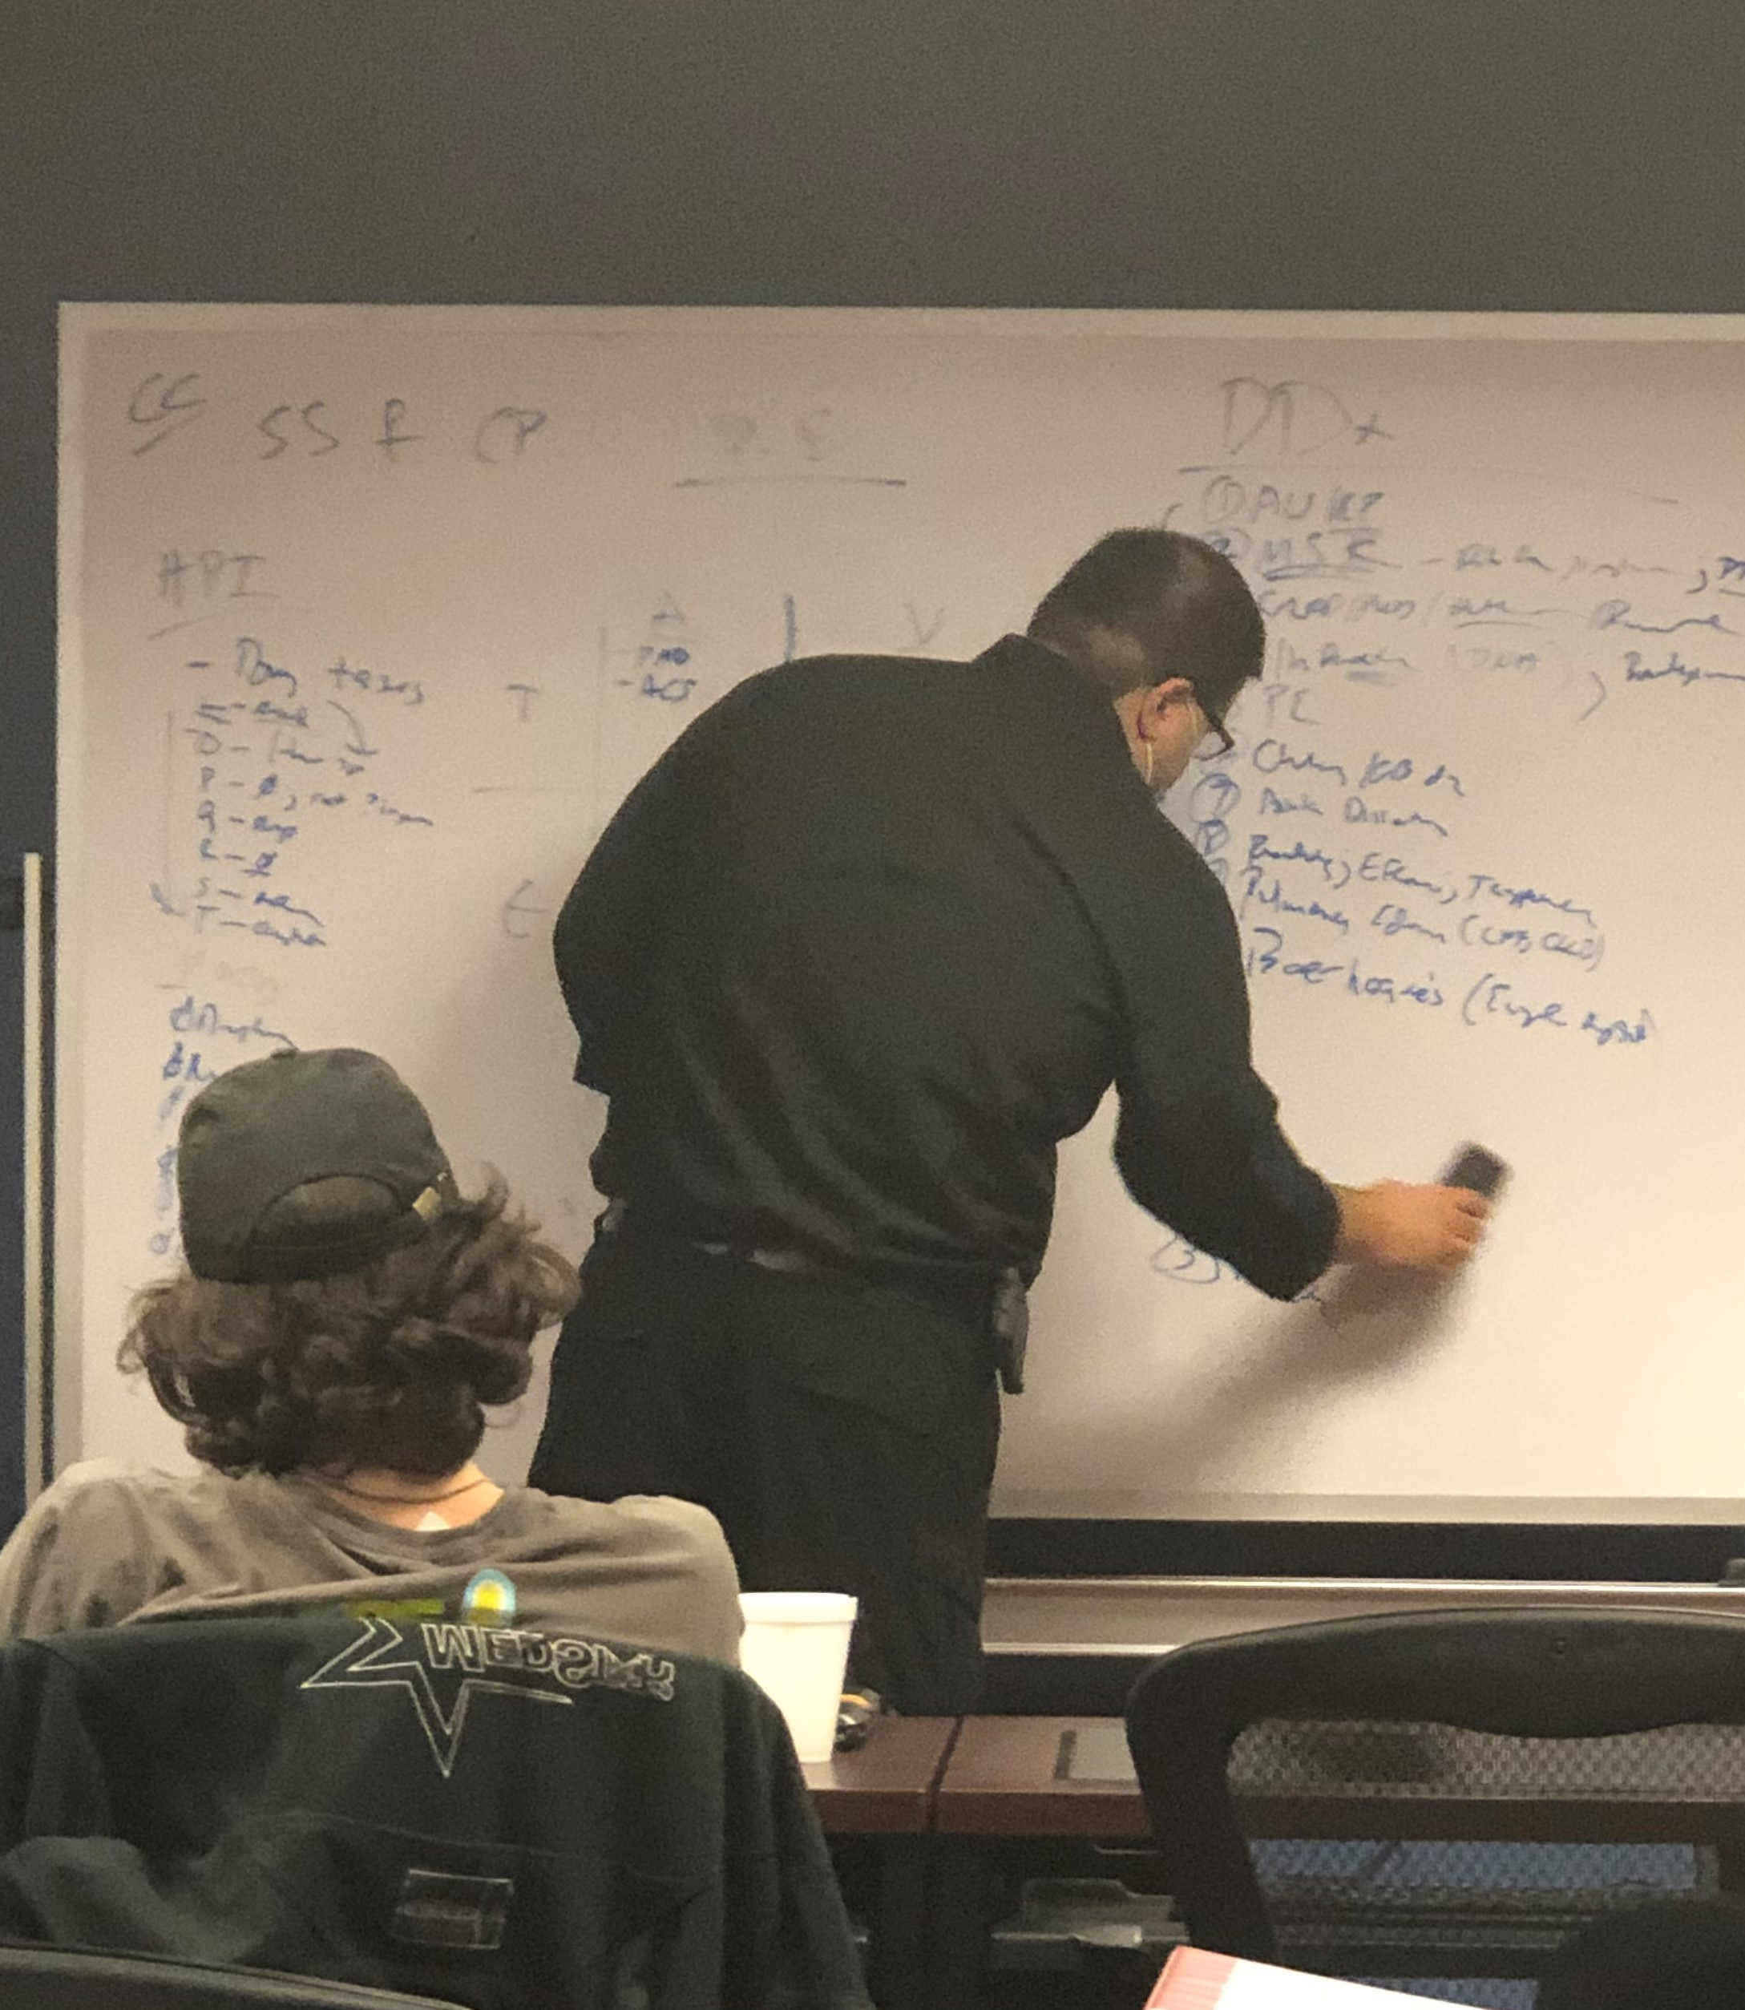
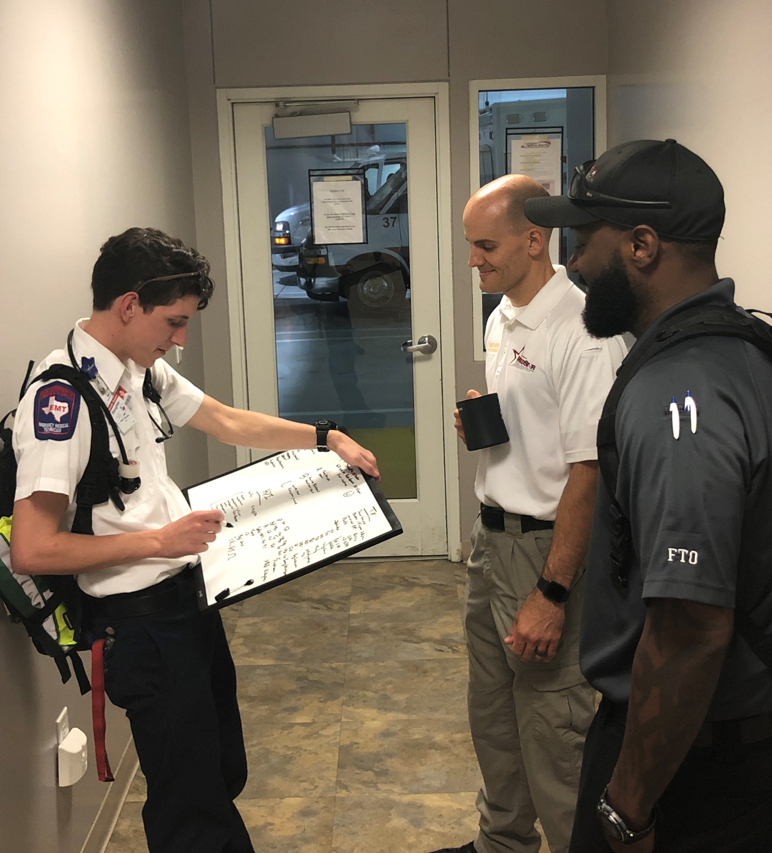
Case-Based
Training & Evaluation

Slide 58
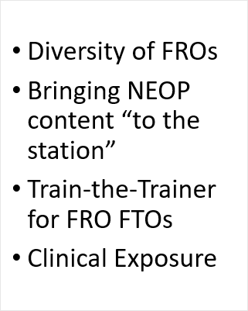
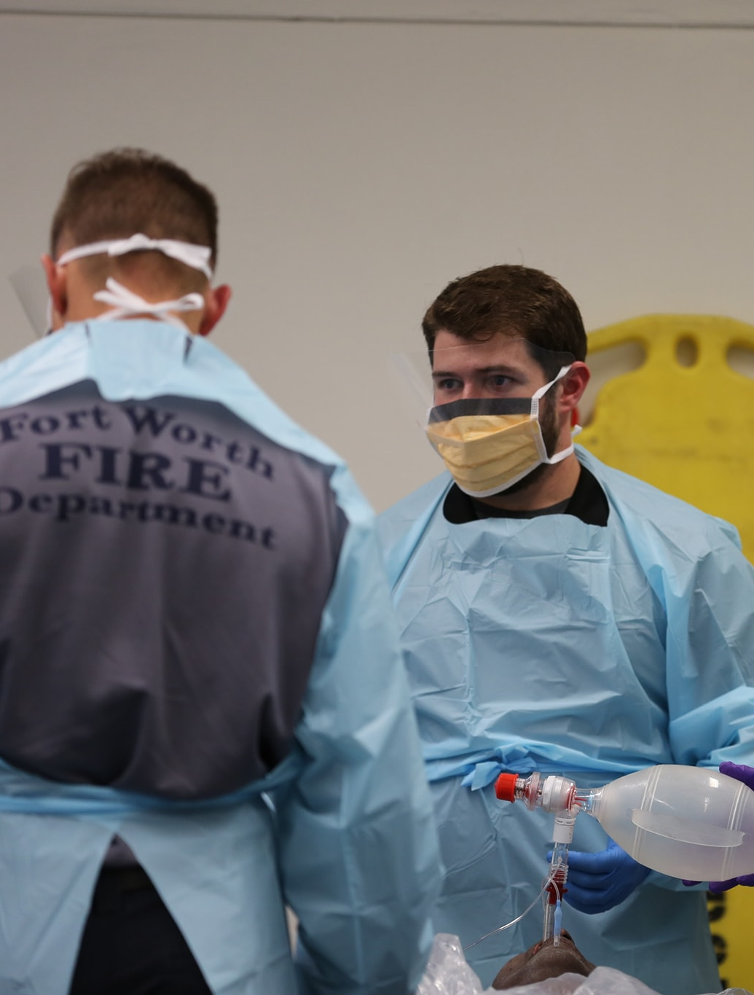
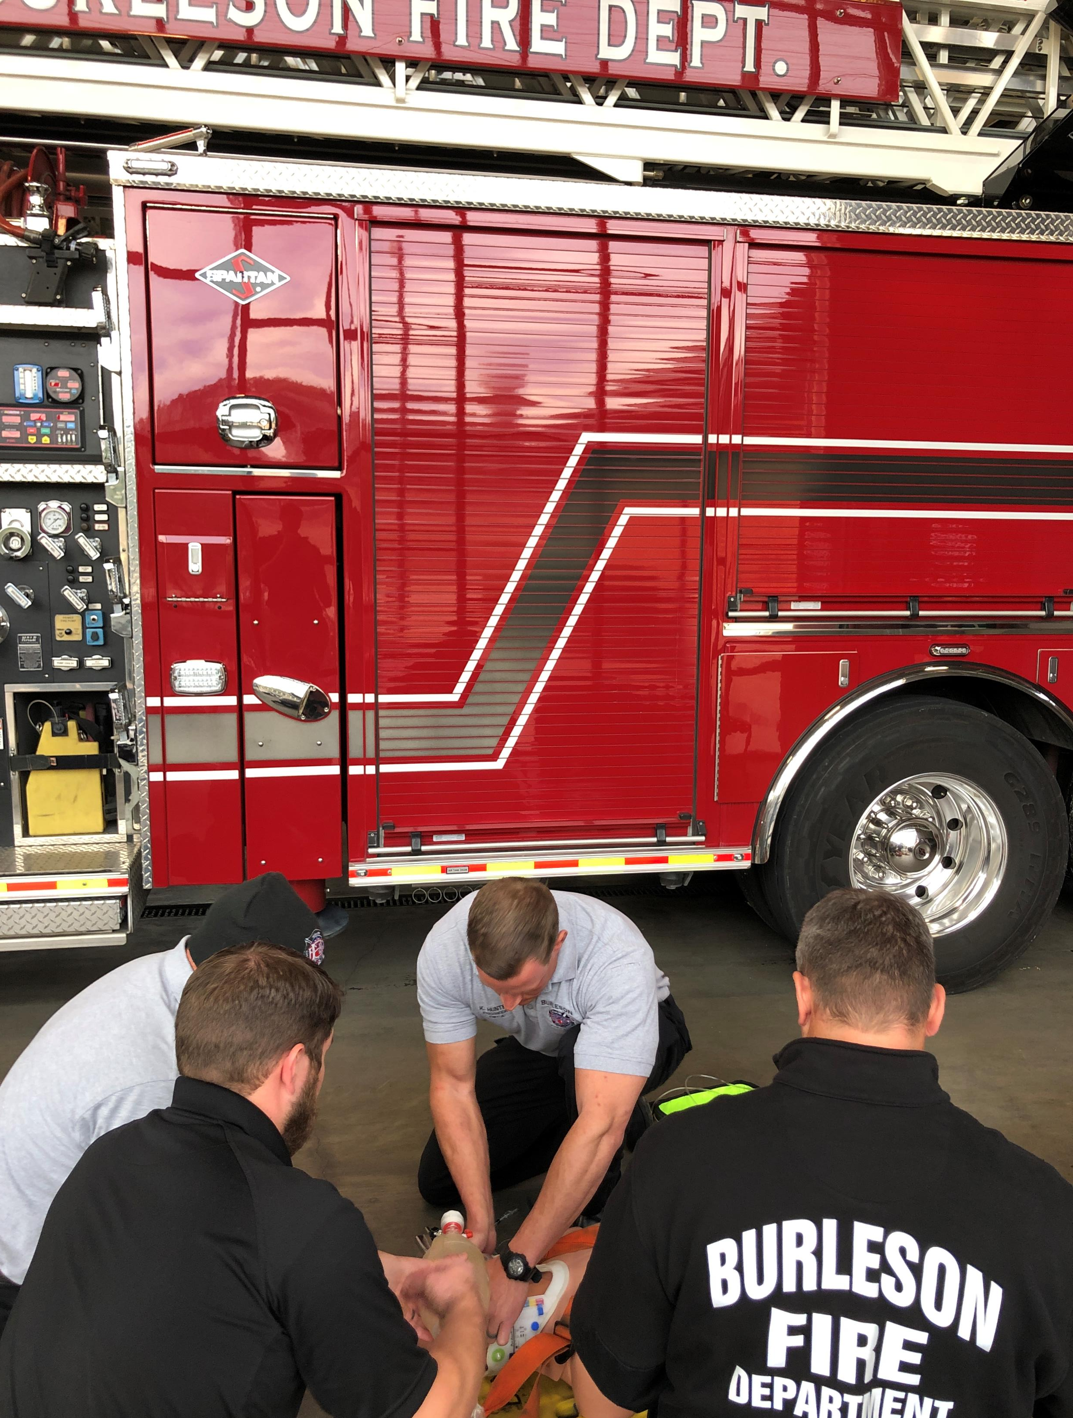
Complexities of Credentialing:
FRO Agencies

Slide 59


EBM Exposure & “The Why”

Slide 60


Slide 61


@BrianMillerMD

